Slide 1

SRI CHANDRASEKHARENDRA SARASWATHI VISWA MAHAVIDYALAYA
(Deemed to be University u/s 3 of UGC Act 1956)
Accredited with ‘A’ by NAAC
Enathur, Kanchipuram – 631 561, Tamil Nadu
www.kanchiuniv.ac.in
DEPARTMENT OF COMPUTER SCIENCE AND ENGINEERING
BCSF186Z90-CIP PROJECT WORK
BUG2SAFE:WEB VULNERABILITY SCANNER
11239A026-E.Sri Thanmai
11239A065-P.S.V.S.Sarvan
Guided By
V. Balu
Assistant professor

Slide 2
BUG2SAFE:WEB VULNERABILITY SCANNER
Abstract
Bug2Safe is a web-based vulnerability scanning tool designed to detect security flaws in web applications.
The system focuses on identifying vulnerabilities based on the OWASP Top 10 security risks.
It provides a simple and user-friendly interface for users without requiring advanced cybersecurity knowledge.
The tool is developed using Flask (Python) for backend and HTML, CSS, JavaScript for frontend.
It performs automated scanning by sending HTTP requests and analyzing server responses.
Detects common vulnerabilities such as SQL Injection and Cross-Site Scripting (XSS).
Includes a secure login system to ensure authorized access.
Scan results are classified into High, Medium, and Low risk levels.
Generates structured reports to help users understand and fix vulnerabilities.
The system is lightweight, efficient, and suitable for both academic and practical use.

Slide 3
BUG2SAFE:WEB VULNERABILITY SCANNER
Problem Statement :
Modern web applications are highly vulnerable to security threats due to improper input validation and insecure coding practices.
Many developers and students lack the expertise or tools required to identify and fix these vulnerabilities effectively.
Existing vulnerability scanning tools are often complex, expensive, or require advanced cybersecurity knowledge to operate.
Critical security risks such as SQL Injection and Cross-Site Scripting remain undetected in many applications.
There is a need for a simple, efficient, and accessible tool that can automatically detect common vulnerabilities.
The absence of user-friendly security tools increases the risk of data breaches and application compromise.
Therefore, a lightweight web-based vulnerability scanner is required to help users identify and understand security flaws easily.

Slide 4
BUG2SAFE:WEB VULNERABILITY SCANNER
S.NO | Author(s)& Year | Title of Work | Method / Approach | Findings
1 | OWASP Foundation (2021) | OWASP TOP 10 | Standarzied classification of vulnerabilities | Identified critical web security risks
2 | Halfond et al. (2006) | SQL Injection Detection | Static & dynamic analysis | Improved XSS detection accuracy
Literature survey:

Slide 5
BUG2SAFE:WEB VULNERABILITY SCANNER
Existing System
Web application security is tested using manual methods and automated vulnerability scanning tools.
These tools detect issues like SQL Injection and Cross-Site Scripting.
Most existing tools are designed for professional or enterprise use.
They often require technical knowledge and complex configurations.
Drawbacks of Existing System
Difficult for beginners to understand and use.
High cost of commercial tools.
Requires skilled professionals to operate.
May produce false or confusing results.
Not suitable for small-scale or academic use.

Slide 6
BUG2SAFE:WEB VULNERABILITY SCANNER
Proposed Method
Bug2Safe is a web-based vulnerability scanner based on OWASP Top 10
Accepts target URL and performs automated security testing
Detects vulnerabilities like SQL Injection and Cross-Site Scripting
Uses HTTP request–response analysis for identifying security flaws
Provides results with risk levels (High, Medium, Low)
Modules Description
Authentication Module: Handles login and user access
URL Input Module: Validates and accepts target URL
Scanning Module: Injects payloads and performs testing
Analysis Module: Evaluates responses and detects vulnerabilities
Reporting Module: Displays structured scan results

Slide 7
BUG2SAFE:WEB VULNERABILITY SCANNER
System Architecture
Client–Server model using Flask backend
Frontend handles user interaction (UI)
Backend processes requests and performs scanning
Scanning engine analyzes responses in real-time
Algorithm Used
Input validation of URL
Send HTTP requests with predefined payloads
Analyze server responses for abnormal patterns
Detect SQL Injection and XSS vulnerabilities
Classify results based on severity
Methodology
Requirement Analysis → System Design
Implementation using Flask, HTML, CSS, JavaScript
Testing with different vulnerability cases

Slide 8
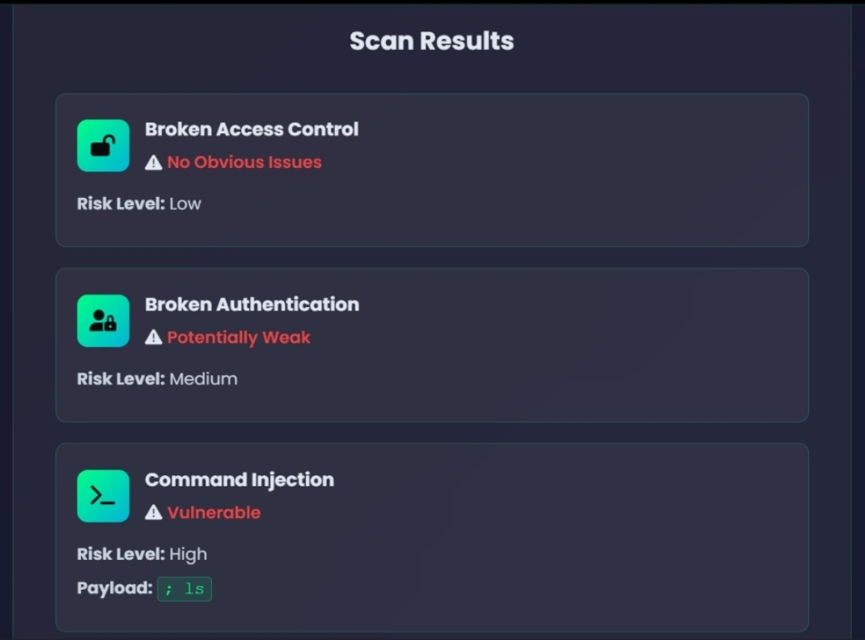
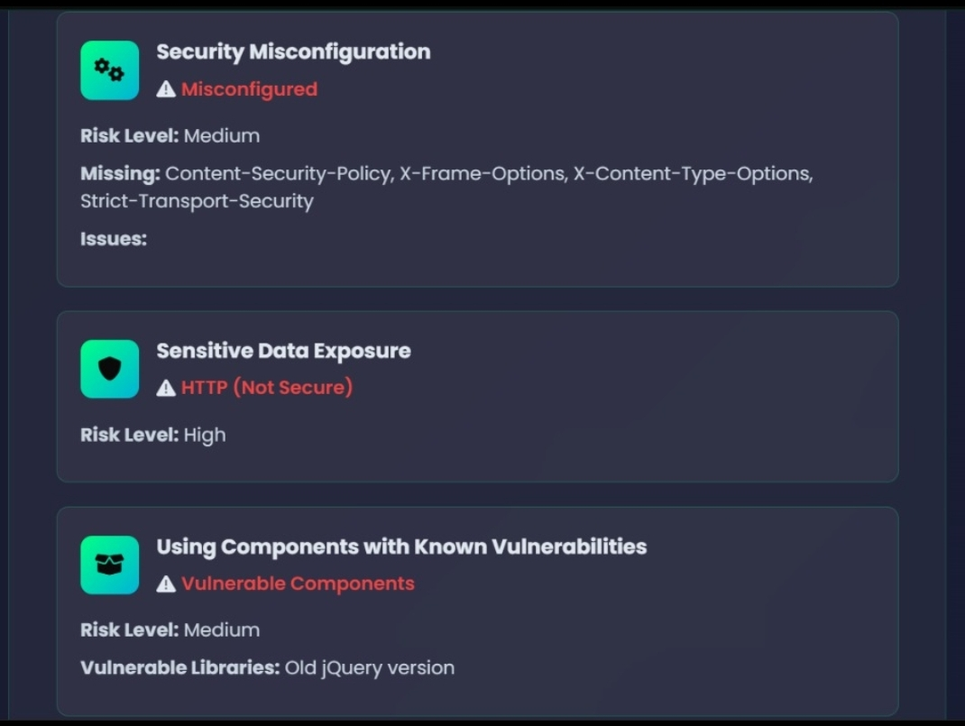
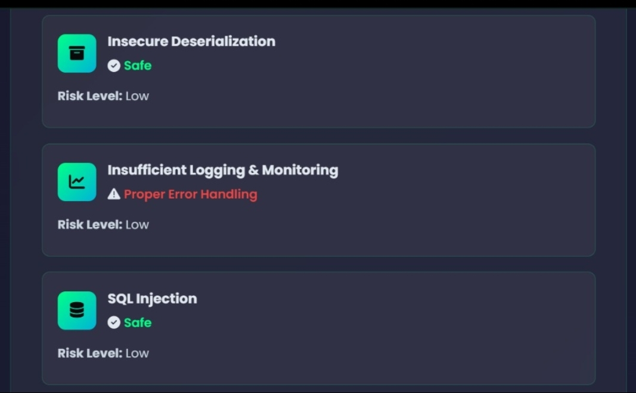
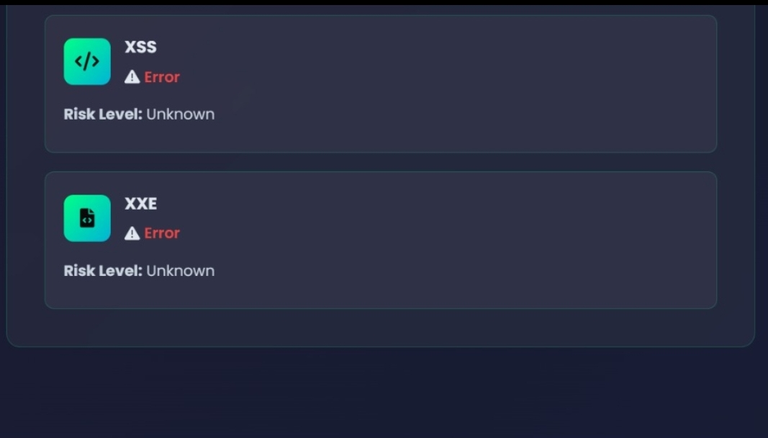
Result & Analysis

Slide 9
Conclusion
Bug2Safe successfully provides a simple and efficient solution for detecting web application vulnerabilities.
The system identifies common security issues such as SQL Injection and Cross-Site Scripting based on OWASP standards.
It simplifies vulnerability scanning, making it accessible to beginners and students.
The tool offers automated scanning with clear and structured results.
Its lightweight design ensures better performance and ease of use.
Overall, Bug2Safe helps improve web application security in an effective and user-friendly manner.

Slide 10
Future Enhancement
Extend support to detect more vulnerabilities beyond OWASP Top 10.
Integrate advanced techniques such as machine learning for smarter detection.
Reduce false positives by improving analysis and validation mechanisms.
Add real-time monitoring and continuous scanning features.
Provide detailed remediation suggestions for each detected vulnerability.
Develop API integration for automated security testing in development pipelines.
Enhance user interface with better visualization and reporting dashboards.
Enable multi-user support with role-based access control.

Slide 11
References
OWASP Foundation, “OWASP Top 10: The Ten Most Critical Web Application Security Risks,” 2021.
W. G. J. Halfond, J. Viegas, and A. Orso, “A Classification of SQL Injection Attacks and Countermeasures,” 2006.
G. Wassermann and Z. Su, “Static Detection of Cross-Site Scripting Vulnerabilities,” 2008.
A. Doupe, M. Cova, and G. Vigna, “Why Johnny Can’t Pentest: An Analysis of Black-Box Web Vulnerability Scanners,” 2010.
L. K. Shar and H. B. K. Tan, “Defending Against Cross-Site Scripting Attacks,” 2012.
S. Gupta and B. B. Gupta, “Web Security Testing Tools: A Comparative Study,” 2017.
R. Patel et al., “Automated Vulnerability Detection Using Machine Learning Techniques,” 2019.

Slide 12

THANK YOU

